Slide 1
Intranet Search Engine

Slide 2
Agenda
Project overview
Product design and implementation
Testing and debugging
Technology and demo

Slide 3
Project Objective and Requirement
Search engine deployed on intranet website.
Help user to search resources in certain website.
We help students to explore resources in CityU CS Dept Website.

Slide 4
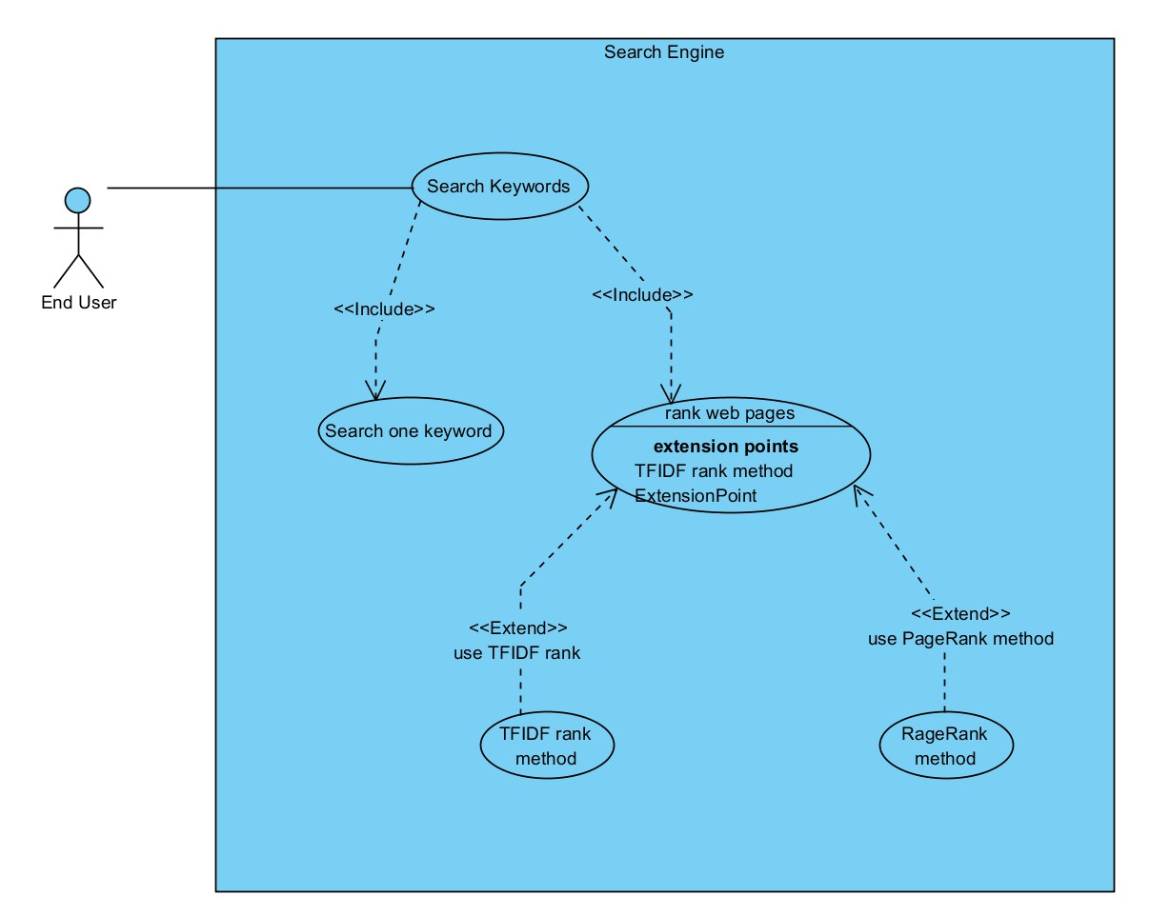
Use case

Slide 5
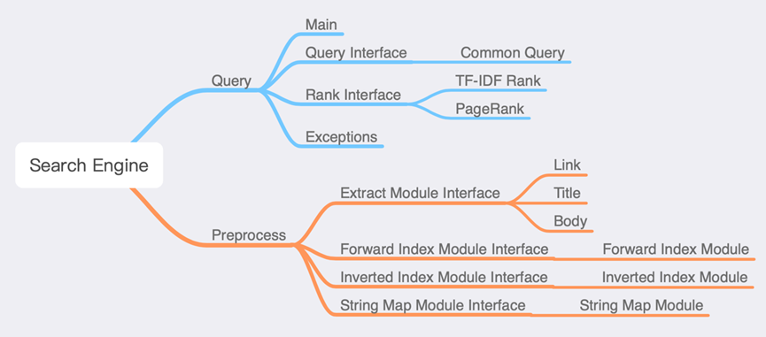
Project architecture

Slide 6
Team Management
Name | Title | Job Description
LI Haoran, Oliver | Project Manager | Management, Development, Testing
ZHAO Zinan | Software Engineer | Development, Testing
HY C Matthew | Software Engineer | Development, Testing
LIU Jinchao | Software Engineer | Development, Testing
GUO Yuhan | Software Engineer | Development, Testing

Slide 7
Development process: Concurrent Engineering Model

Slide 8
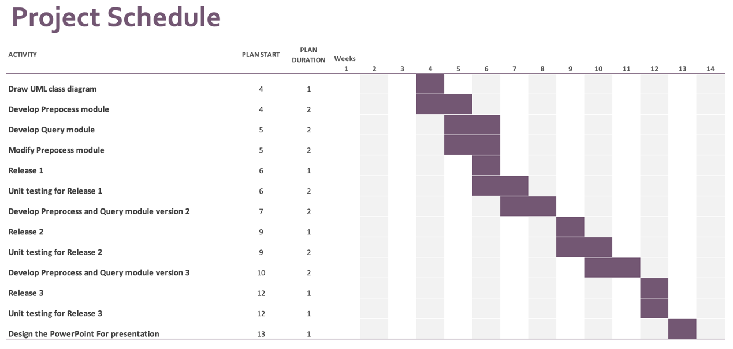
Project schedule

Slide 9
Preprocess

Slide 10
The purpose of preprocess
Our search engine has two methods ranking the webpage
TFIDF and PageRank
TFIDF : Count the term frequency in list of keywords
PageRank : Algorithm by counting the number of hyperlinks

Slide 11
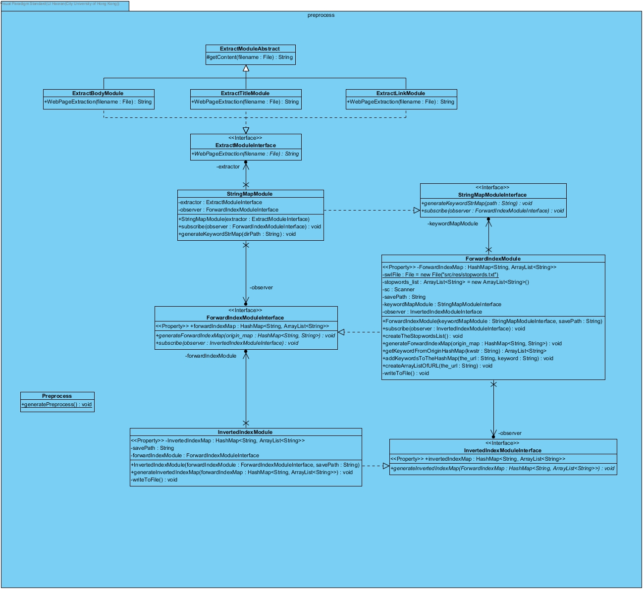

Slide 12
Flow of the preprocess
Html file
Content of webpage
Hashmap<url, arraylist of keywords>
Hashmap<keyword, arraylist of urls>

Slide 13
StringMapModule
Generate the dataset file
ForwardIndexDataset
InvertedIndexDataset
linkForwardIndexDataset
linkInvertedIndexDataset

Slide 14
ExtractBodyModule
Method: WebPageExtraction
Input: html file of the webpage
Return Type: String
Return: content of the webpage without the html tag, header…
Use for the TFIDF algorithm

Slide 15
ExtractLinkModule
Method: WebPageExtraction
Input: html file of the webpage
Return Type: String
Return: the hyperlink of the webpage
Use for the PageRank algorithm

Slide 16
ForwardIndexModule
Create a hash map with URL and keywords
Remove stop words from the content of the webpage
Input: content of webpage
Output Type: HashMap<String, ArrayList<String>>
Output: URL, Array list of keywords

Slide 17
InvertedIndexModule
Invert the ForwardIndexModule
Input: HashMap<URL, Array list of keywords>
Output Type: HashMap<String, ArrayList<String>>
Output: Keyword, Array list of URL

Slide 18
Software design pattern
StringMapModule
HashMap<String, String>
Key: URL
Value: Content of webpage
InvertedIndexModule
HashMap<String, ArrayList<String>>
Key: Keyword
Value: URL
ForwardIndexModule
HashMap<String, ArrayList<String>>
Key: URL
Value: Keywords
Observer pattern
Observer pattern is used in those 3 classes.
Observer pattern can update the final hash map automatically

Slide 19
Query

Slide 20
Class Diagram

Slide 21
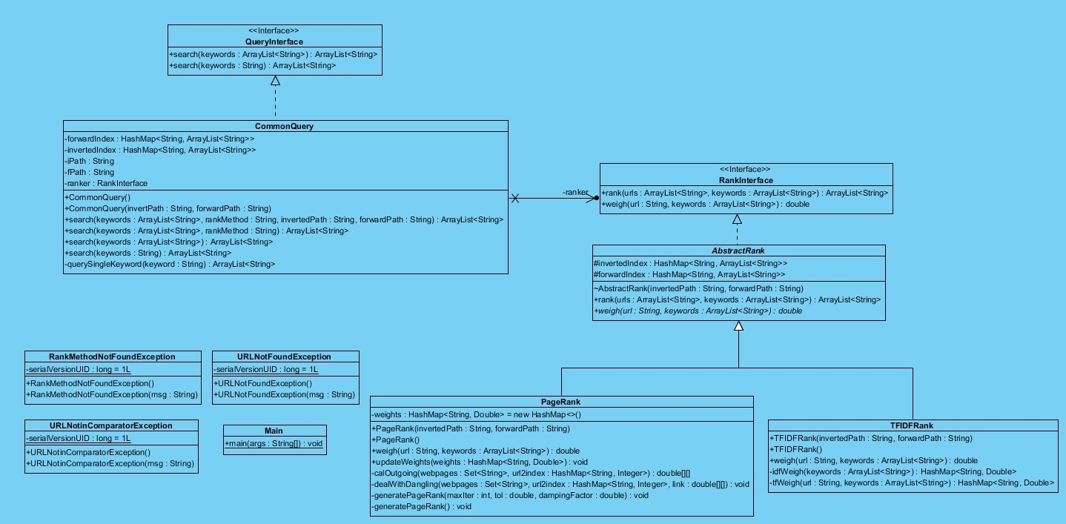

Slide 22
Pattern and Principle

Slide 23
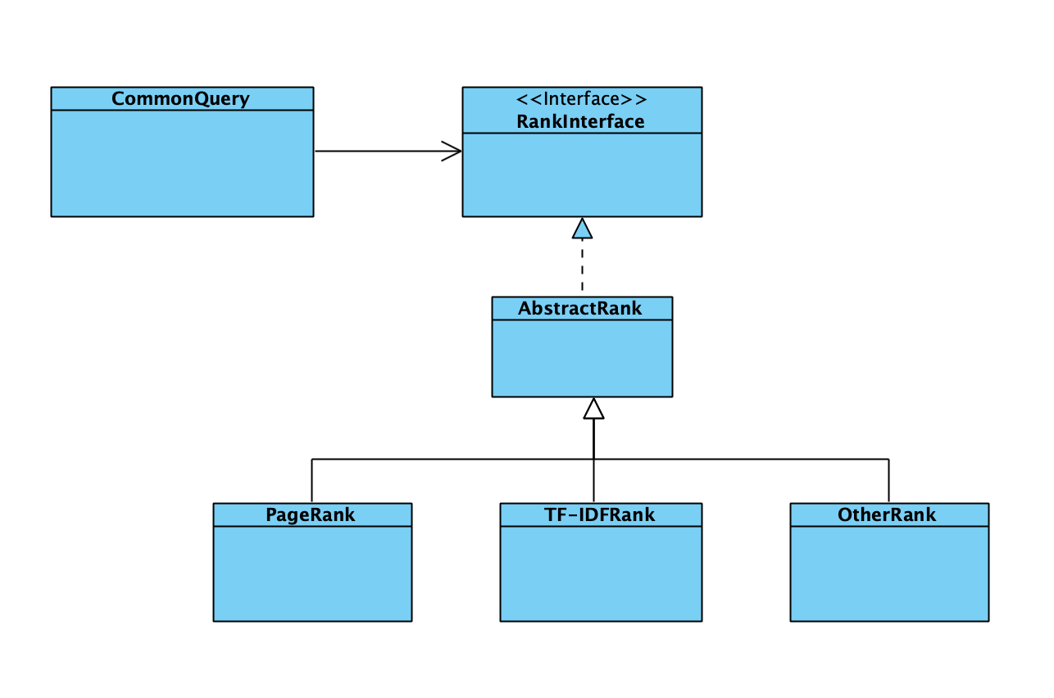
Open-Closed Principle + Strategy Pattern

Slide 24
Algorithm & Implement

Slide 26
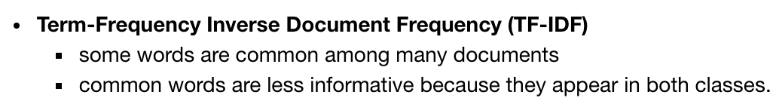
TF-IDF

Slide 27
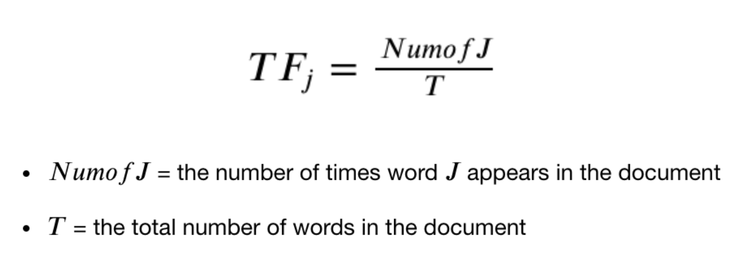

Slide 28
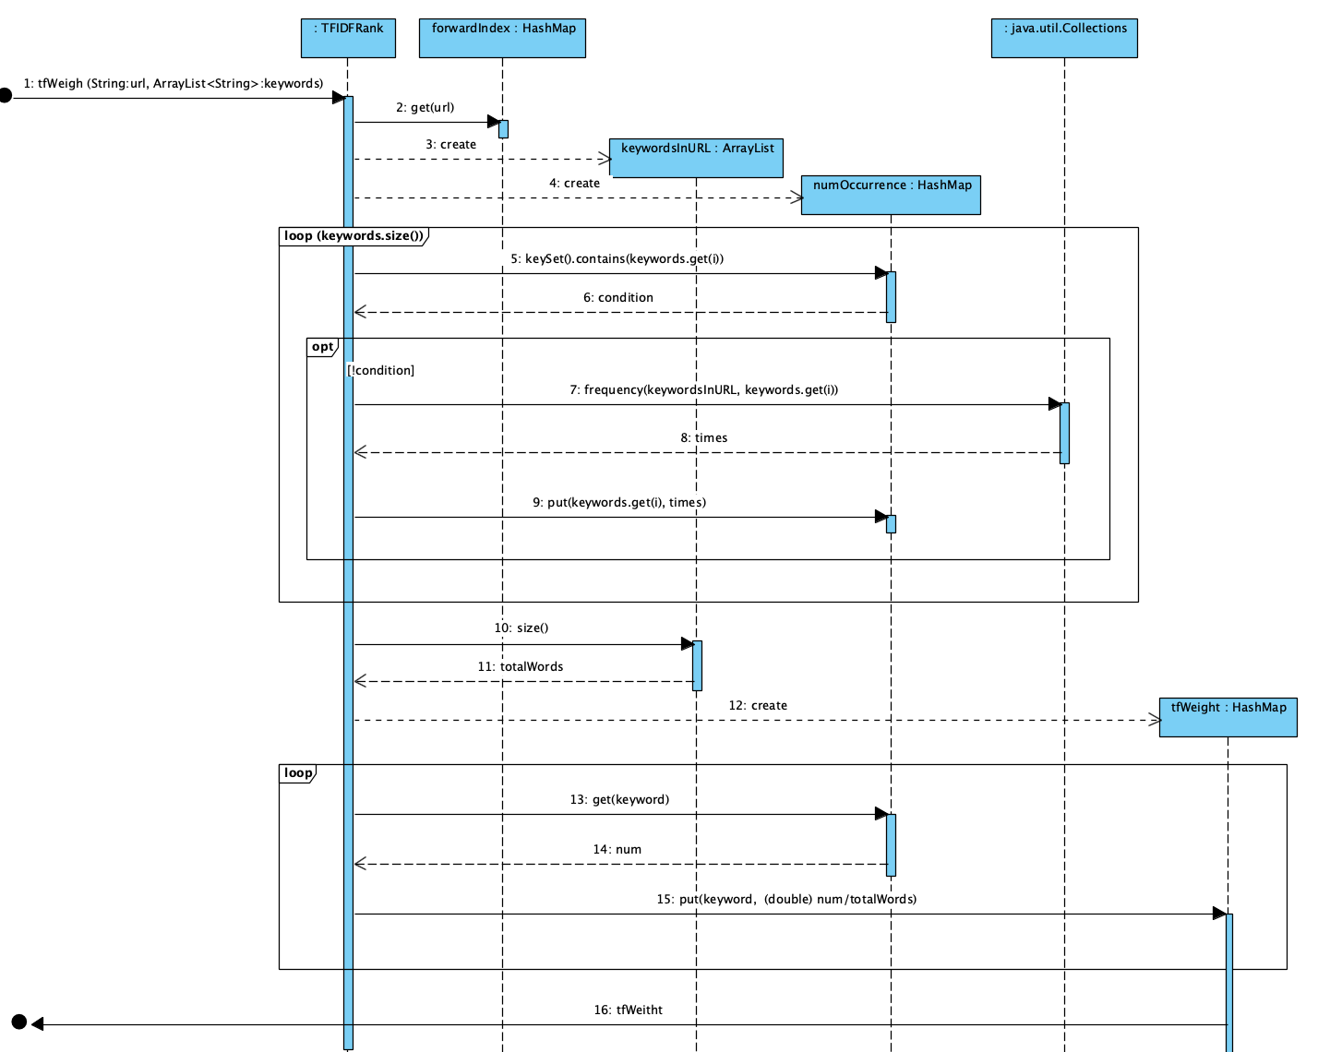

Slide 29
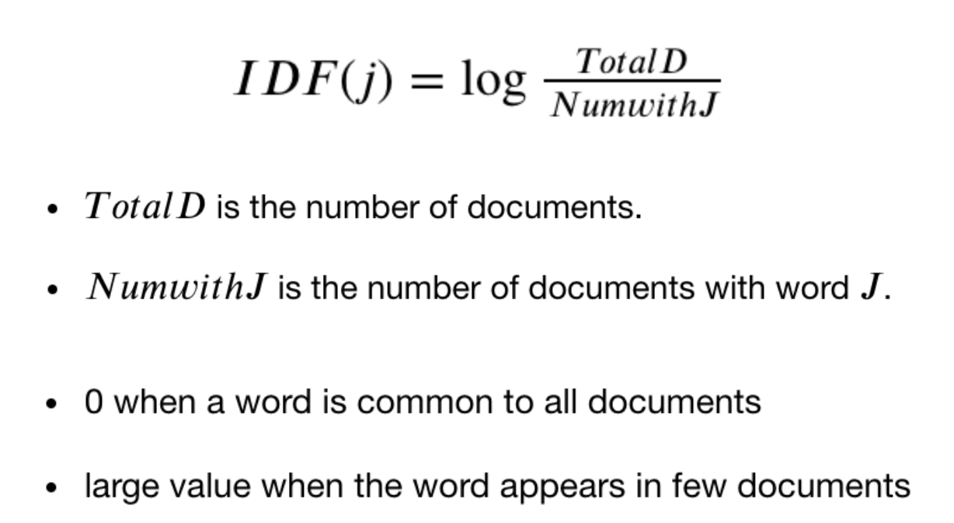

Slide 30
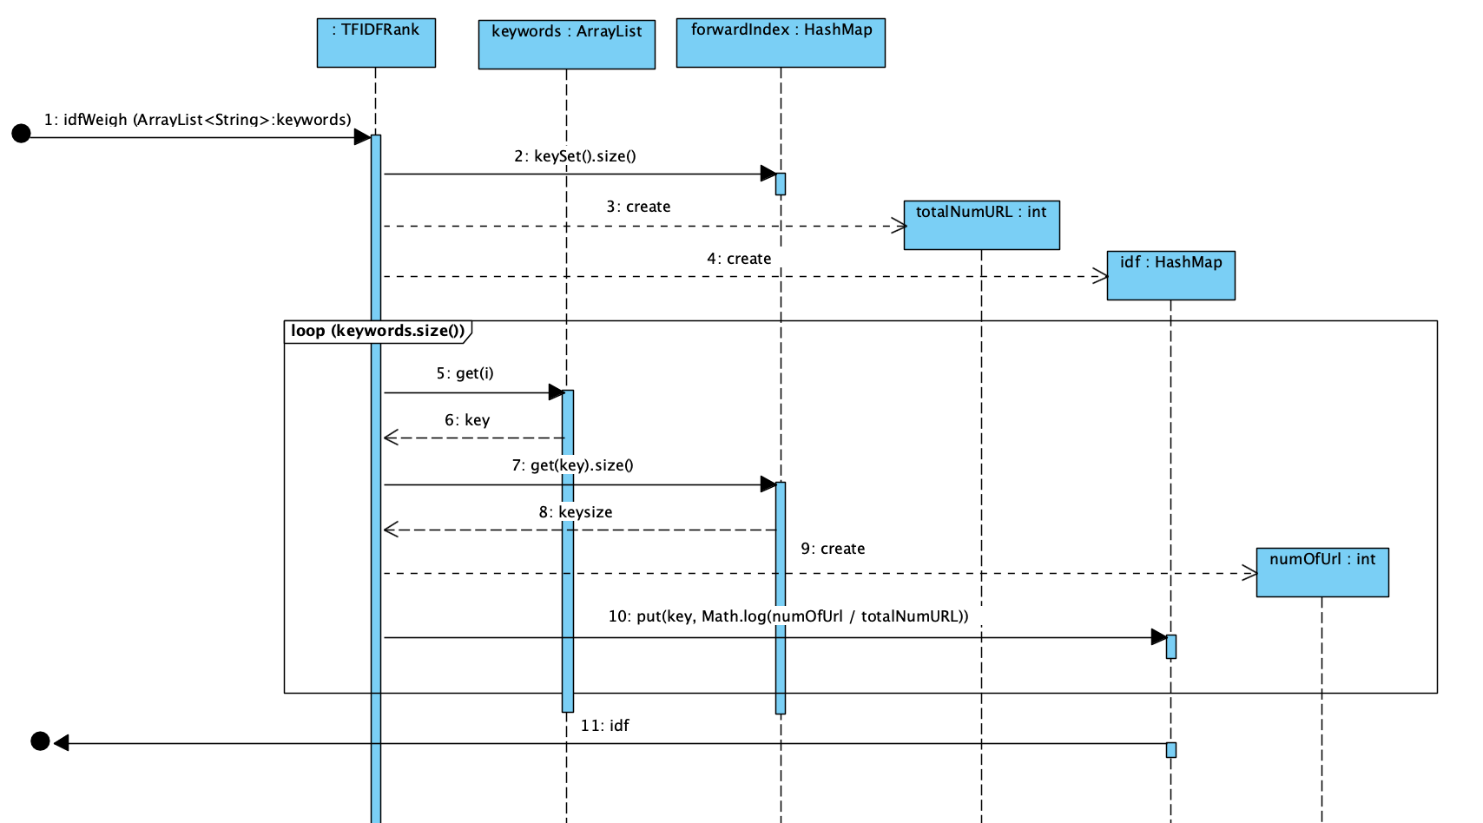

Slide 31
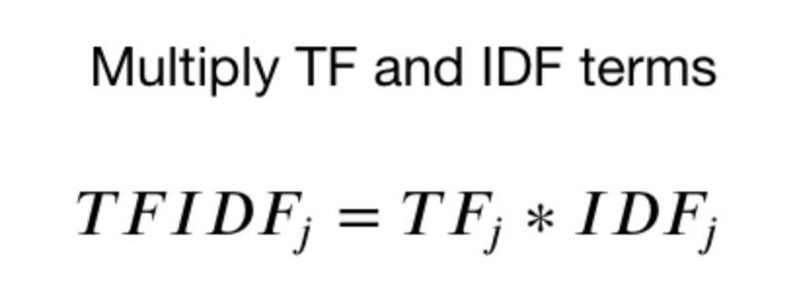
TF-IDF vector

Slide 32
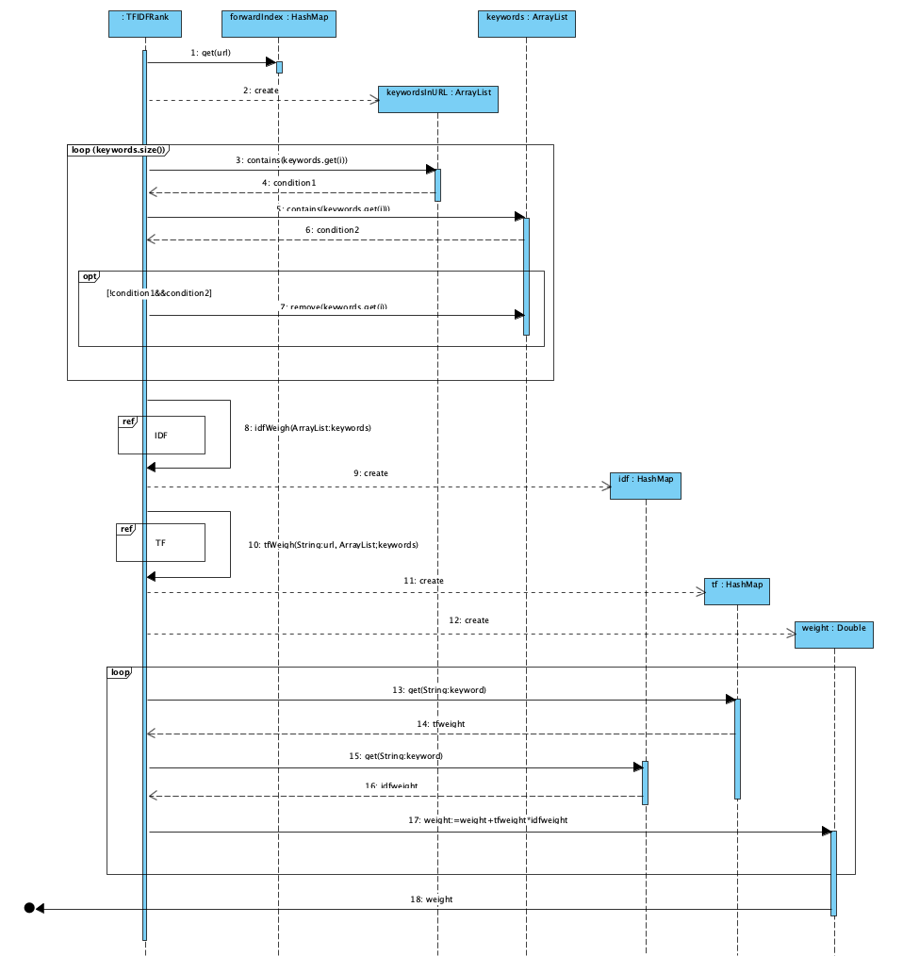

Slide 33
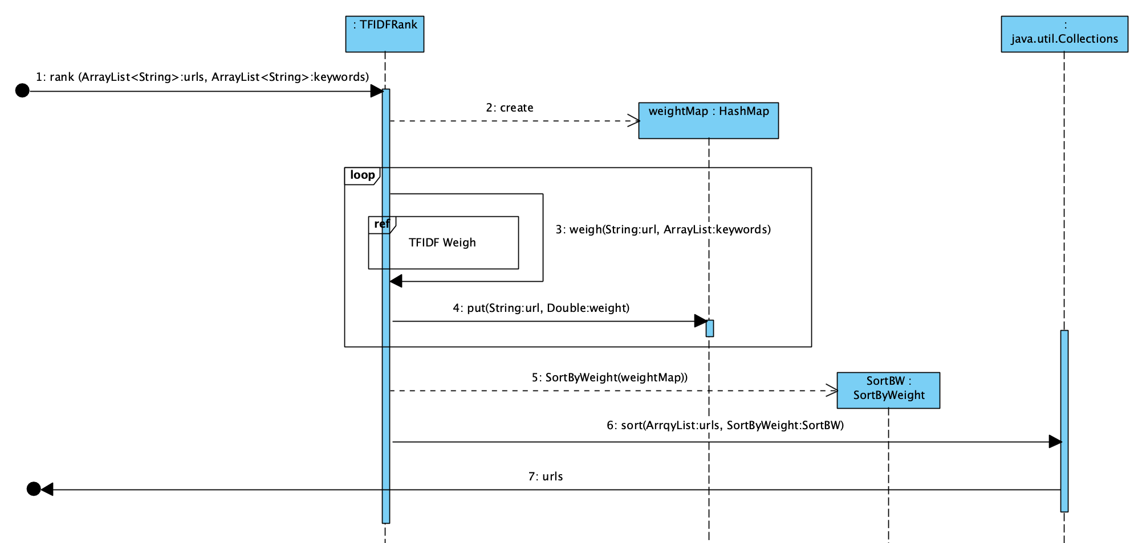

Slide 34
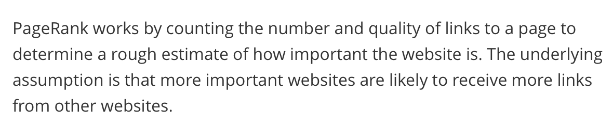
PageRank

Slide 35
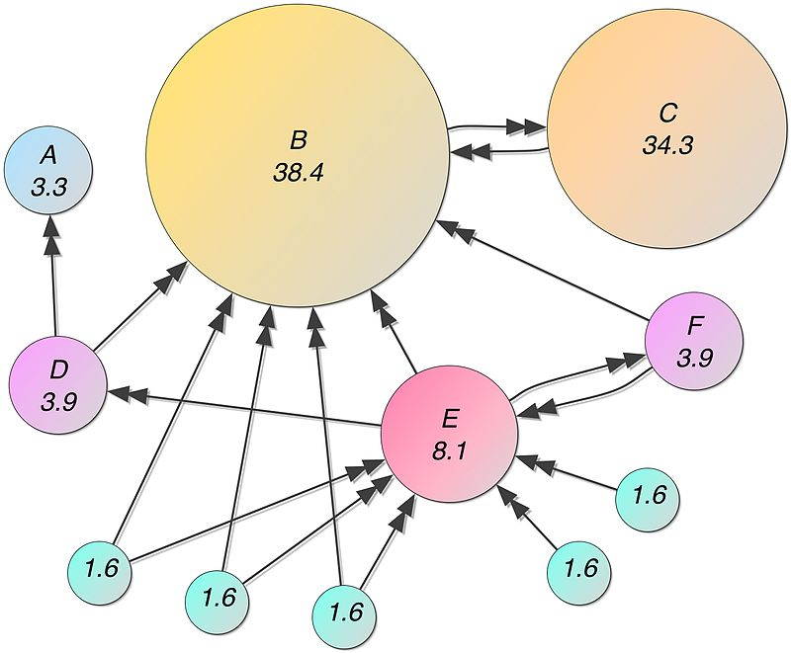

Slide 36
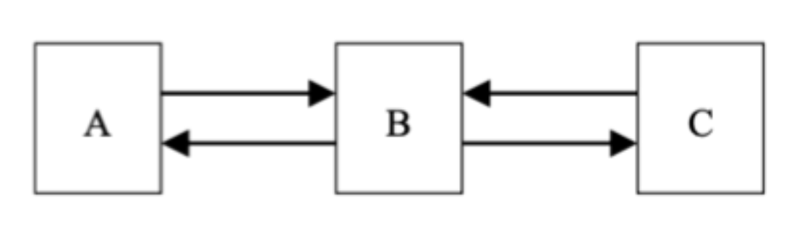
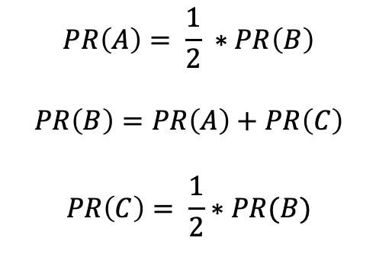
$$PR\left(A\right)= \frac{1}{2} ∗PR\left(B\right)$$
$$PR\left(B\right)=PR\left(A\right)+PR\left(C\right)$$
$$PR\left(C\right)= \frac{1}{2}∗PR(B)$$

Slide 37
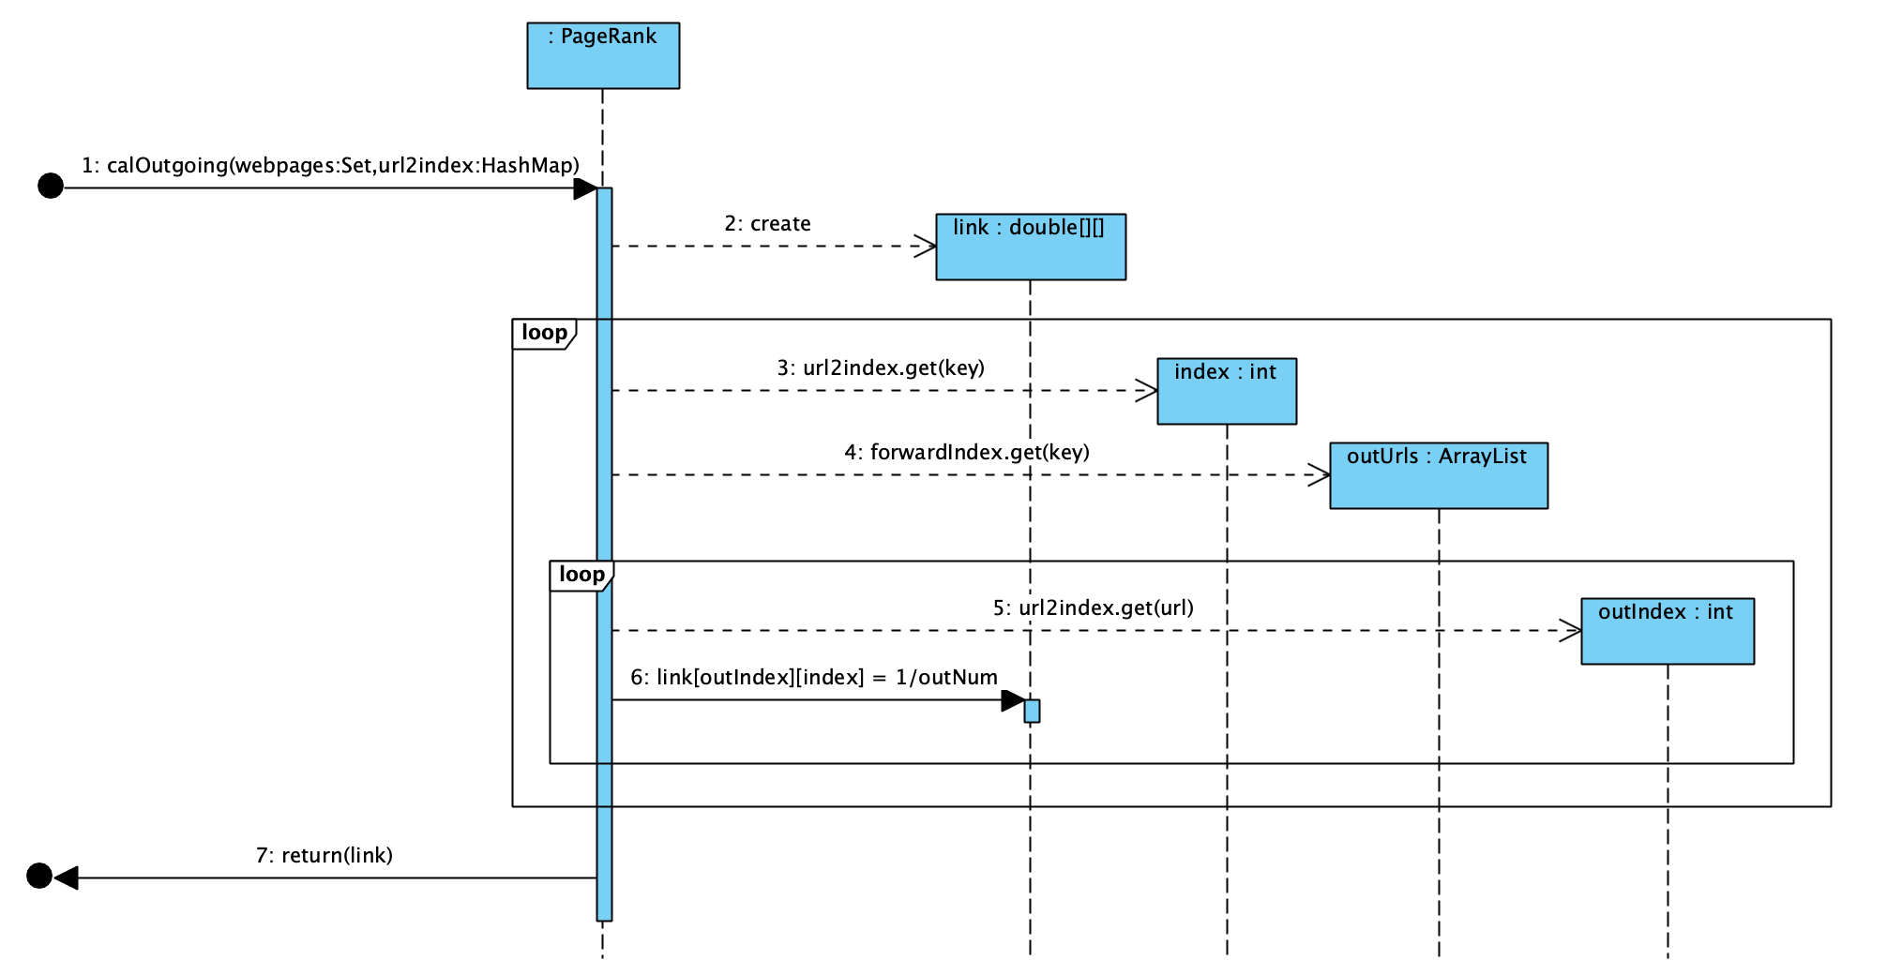

Slide 38
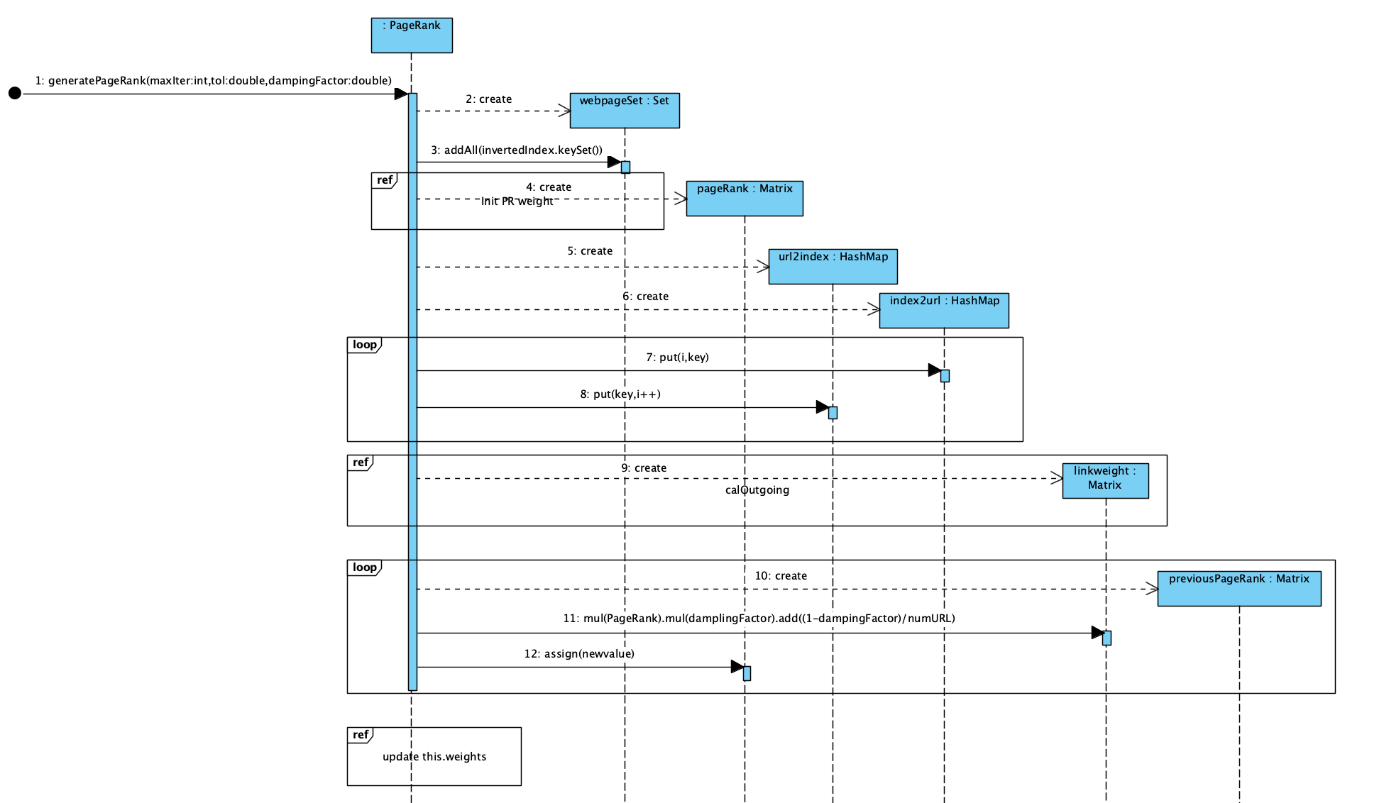

Slide 39


Slide 40
Bug Report

Slide 41
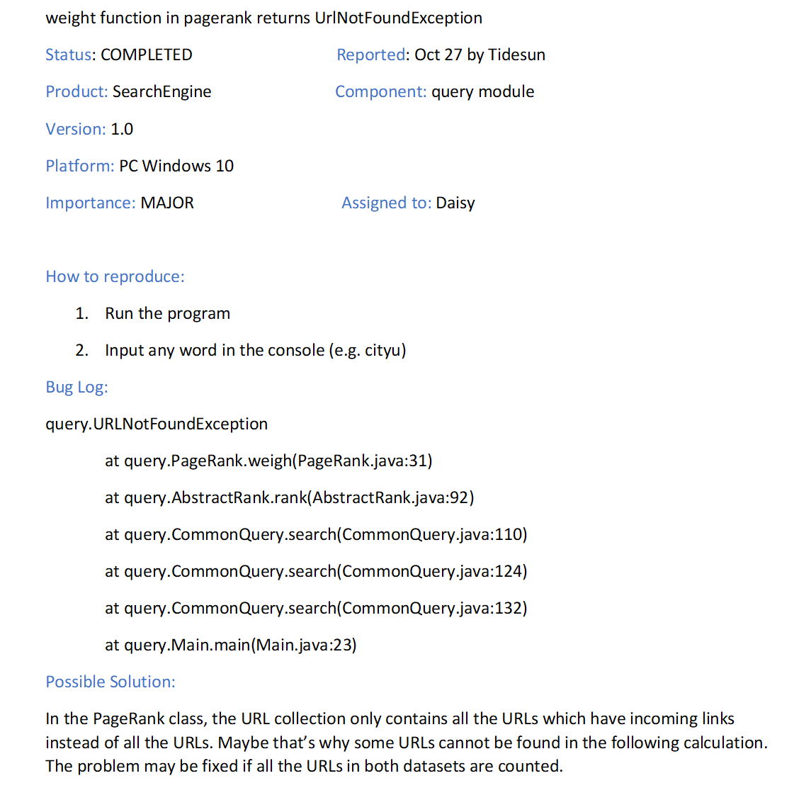
Bug One
Unexpected Exception

Slide 42
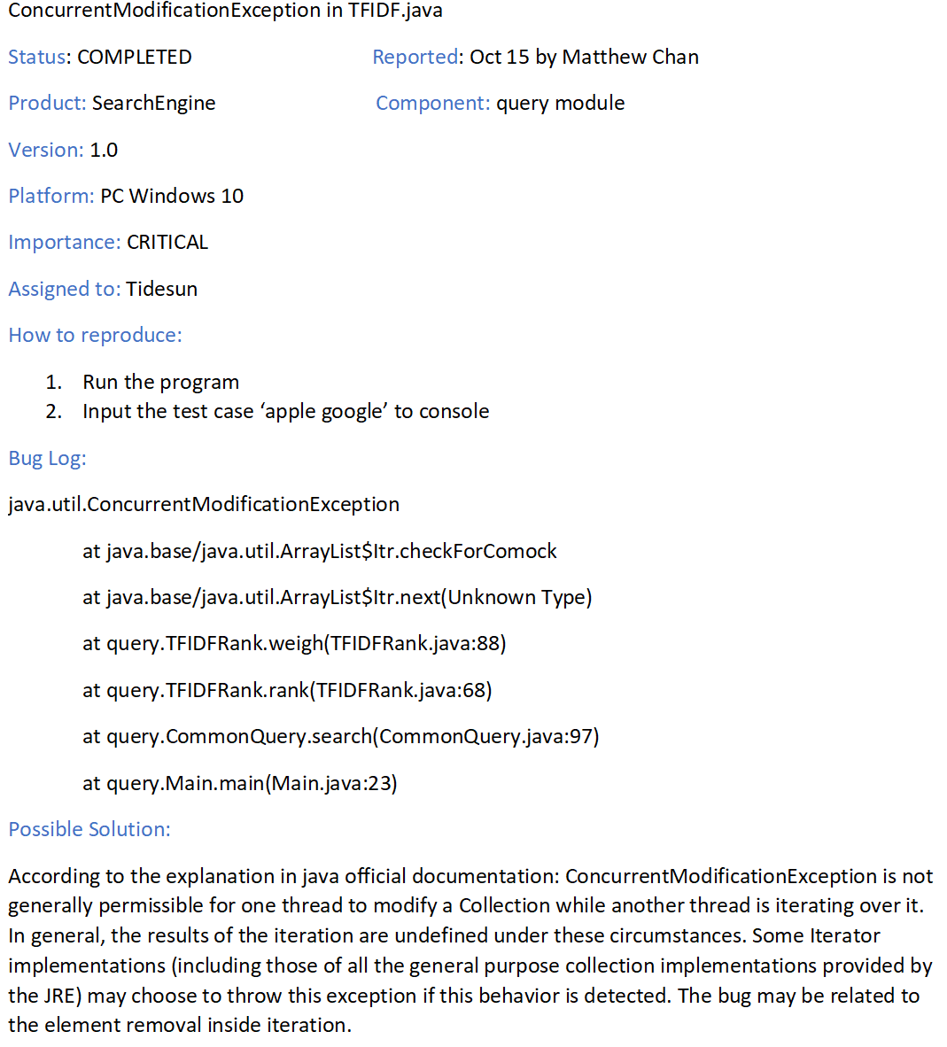
Bug Two
Exception because of design of Java language

Slide 43
Test Organization

Slide 44
Query
CommonQuery
AbstractRank
TFIDF
PageRank

Slide 45
Pre-process
ExtractModuleAbstract
ExtractBodyModule
ExtractTitleModule
ExtractLinkModule
StringMapModule
ForwardIndexModule
InvertedIndexModule

Slide 46


Pre-process
ExtractModuleAbstract
ExtractBodyModule
ExtractTitleModule
ExtractLinkModule
StringMapModule
Unit Testing
ForwardIndexModule
InvertedIndexModule

Slide 47

Pre-process
ExtractModuleAbstract
ExtractBodyModule
ExtractTitleModule
ExtractLinkModule
StringMapModule
Unit Testing
ForwardIndexModule
InvertedIndexModule

Slide 48

Pre-process
ExtractModuleAbstract
ExtractBodyModule
ExtractTitleModule
ExtractLinkModule
StringMapModule
Integration Testing
ForwardIndexModule
InvertedIndexModule

Slide 49

Pre-process
ExtractModuleAbstract
ExtractBodyModule
ExtractTitleModule
ExtractLinkModule
StringMapModule
Unit Testing
ForwardIndexModule
InvertedIndexModule

Slide 50

Pre-process
ExtractModuleAbstract
ExtractBodyModule
ExtractTitleModule
ExtractLinkModule
StringMapModule
Integration Testing
ForwardIndexModule
InvertedIndexModule

Slide 51

Pre-process
ExtractModuleAbstract
ExtractBodyModule
ExtractTitleModule
ExtractLinkModule
StringMapModule
Unit Testing
ForwardIndexModule
InvertedIndexModule

Slide 52

Pre-process
ExtractModuleAbstract
ExtractBodyModule
ExtractTitleModule
ExtractLinkModule
StringMapModule
System Testing ->
Black Box Testing
ForwardIndexModule
InvertedIndexModule

Slide 53
Test Comprehensiveness

Slide 54
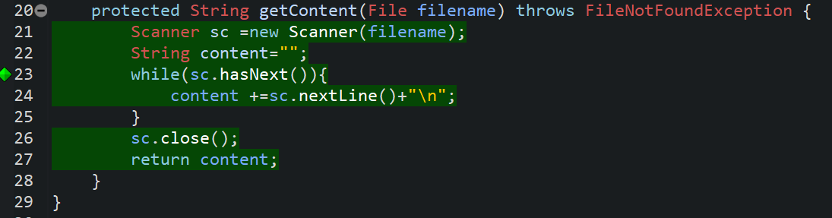
Loop Coverage

Slide 55
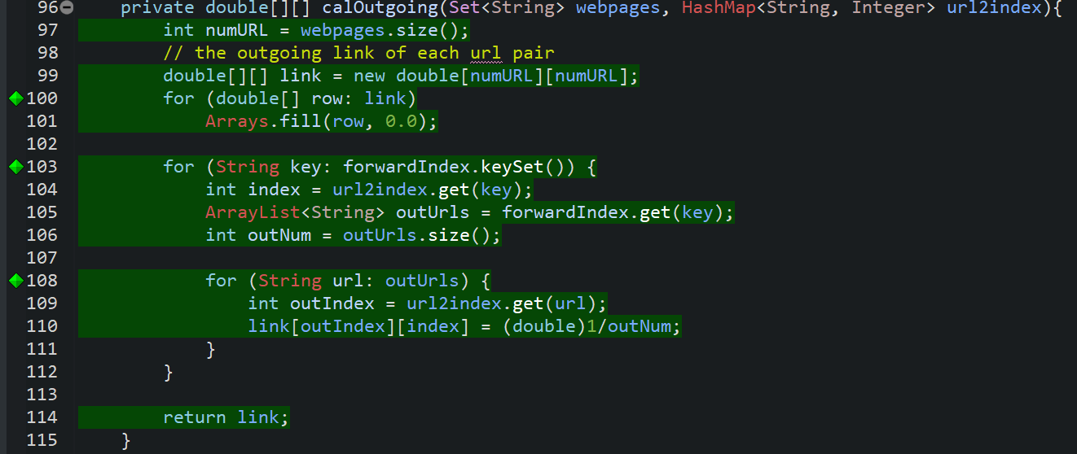
Path Coverage

Slide 56
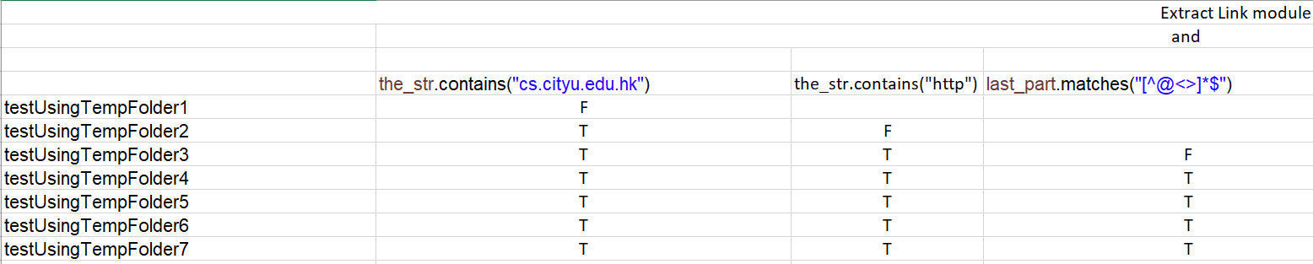
MC/DC Predicate Testing

Slide 57
Technology

Slide 58
Development Tools and Testing Tools
Eclipse IDE for Java Developers Version: 2018-09 (4.9.0)
JUnit 4

Slide 59
Development and Testing Platform
a. Mac OS X 10.14.1
b. Windows 10 1607

Slide 60
Documentation
Visual Paradigm Version 15.1 Build 20181103: Sequence
Diagrams, Class Diagrams and Use Case Diagrams
Javadoc: Generating Java manual
Bugzilla: Bug report
Microsoft Word: Reports

Slide 61
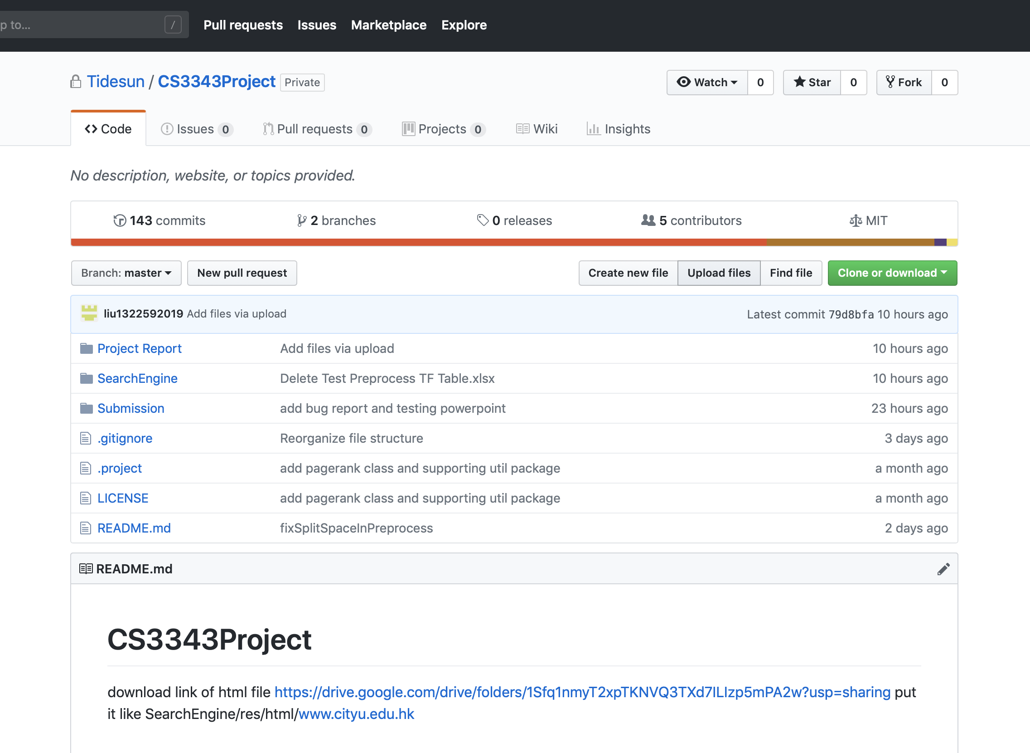
Project Management
GitHub
Hosting various versions of source code ->allows the same team users to cooperate by working on different parts and confirm the schedule of the project.

Slide 62
Demo

Slide 63
Q&A

